Slide 1
A Campaign to Conserve The Paul Tomasso Memorial Forest
September 6th, 2017

Slide 2
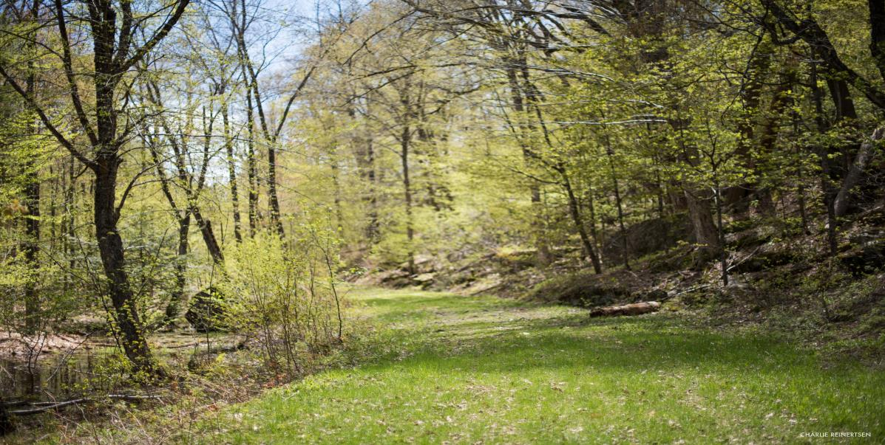
New England Forestry Foundation
Conserving Forests for Future Generations

Slide 3
Mission
New England Forestry Foundation works to conserve forests for future generations. Founded in 1944, New England Forestry Foundation (NEFF) has conserved 1.2 million acres of forest, including one out of every three acres of forestland protected in New England since 1999. We are committed to conserving a wide array of forest benefits to advance conservation and exemplary forest management throughout the region.

Slide 4
Conserving Forests

Slide 5
How NEFF Works

Slide 6
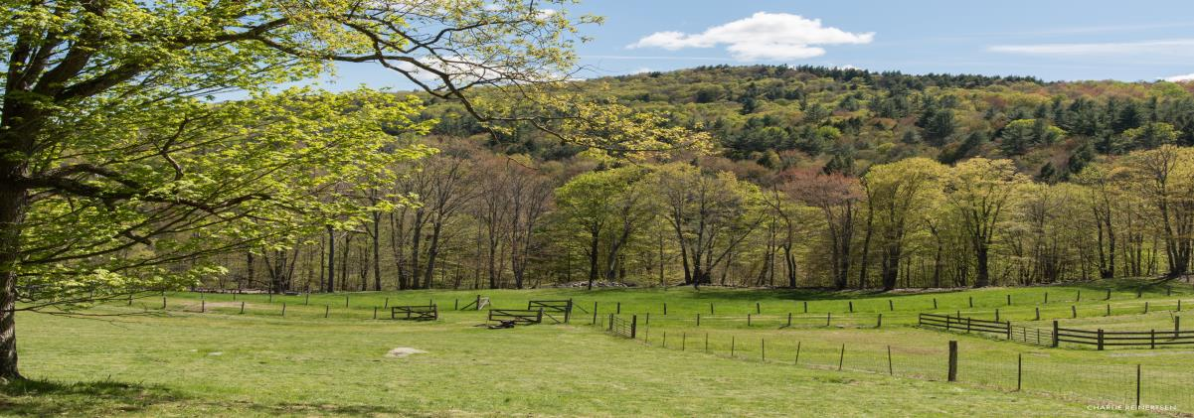
Lead by Example
NEFF owns 142 community forests, practicing sustainable forestry while providing opportunities for public recreation.

Slide 7
Innovation for Impact
NEFF develops new tools for communicating effectively with private landowners, more economically efficient market-based approaches to conserve large forested areas, and meaningful partnerships and programs to achieve region-wide impact.

Slide 8
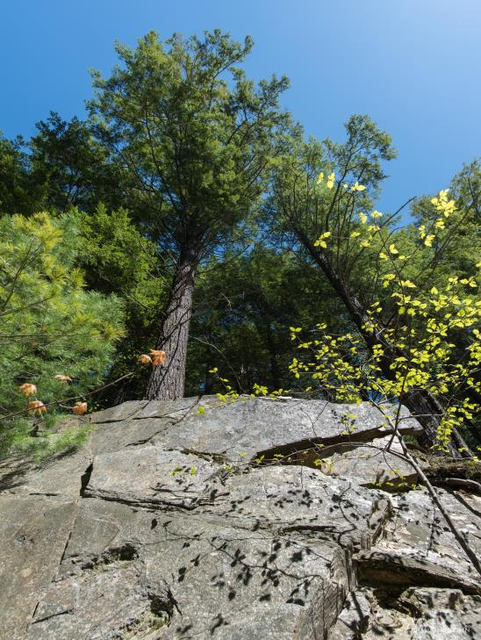
Focus on the Future
NEFF works towards a sustainable way of life, ensuring that forests continue to support the region’s communities and all future generations.

Slide 9
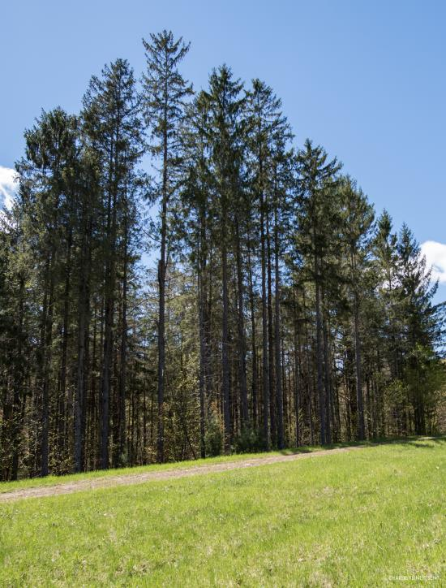
Serve a Movement
Through education, advocacy, and fundraising, NEFF continues to forge new connections to keep New England forested.

Slide 10
Programs

Slide 11
Build It With Wood
Aims to increase the use of wood in long-lasting construction, which will revolutionize U.S. construction practices, help mitigate climate change, enhance sustainable forest management, create new jobs and improve regional construction costs and quality.

Slide 12
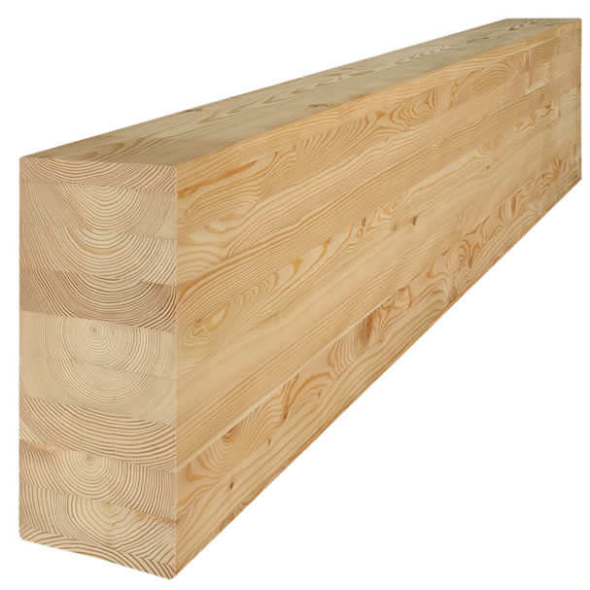
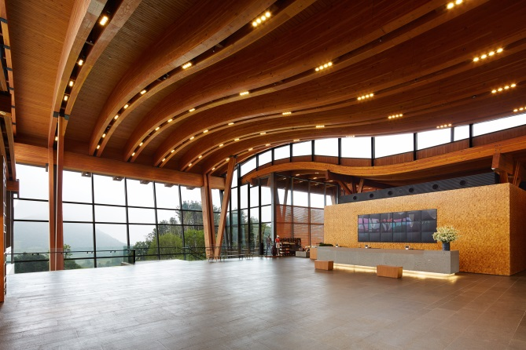

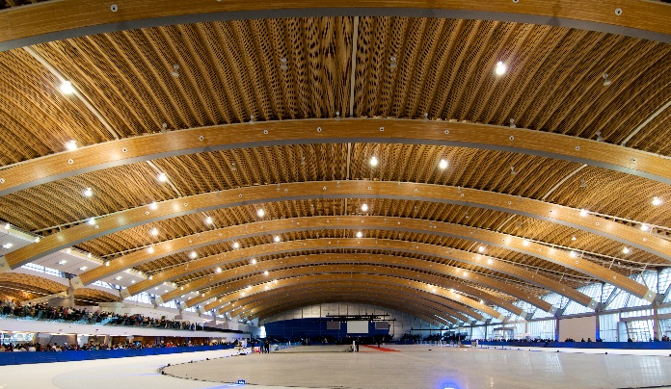

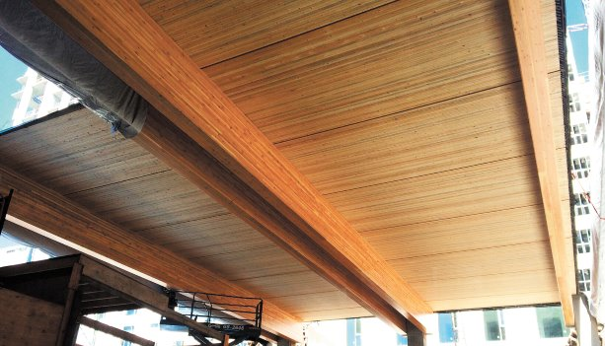
Mass Timber & Engineered Wood Products
Glulam
CLT
NLT

Slide 13
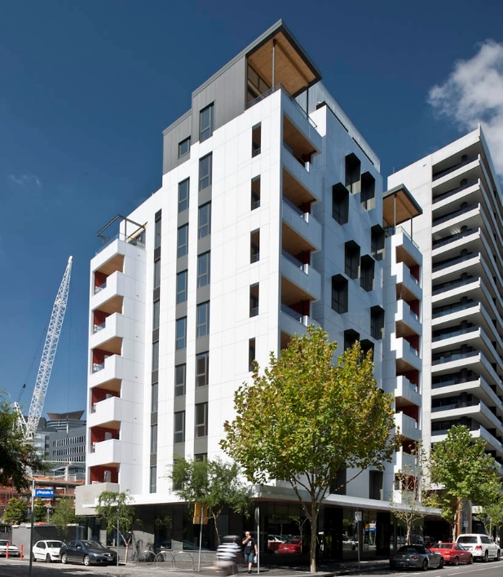
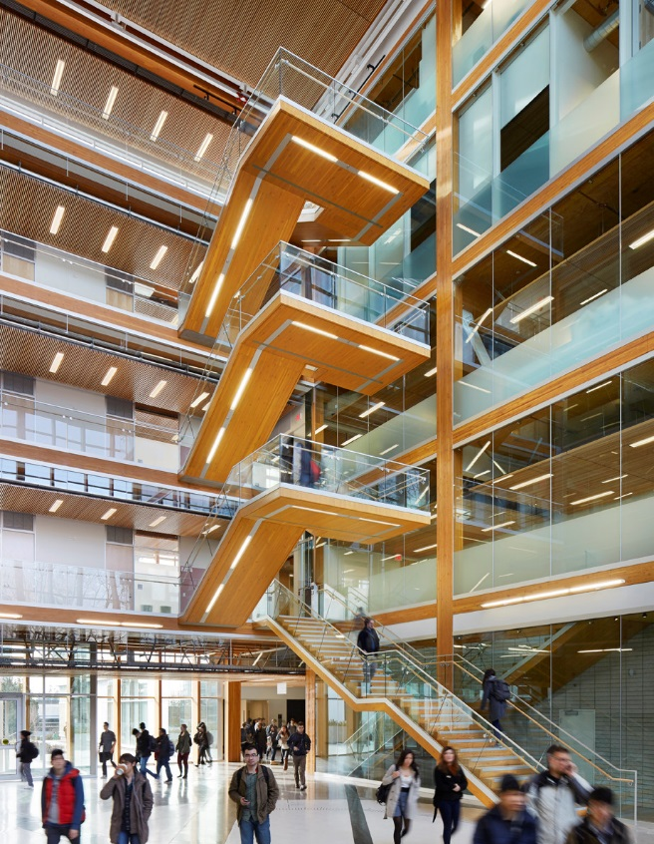

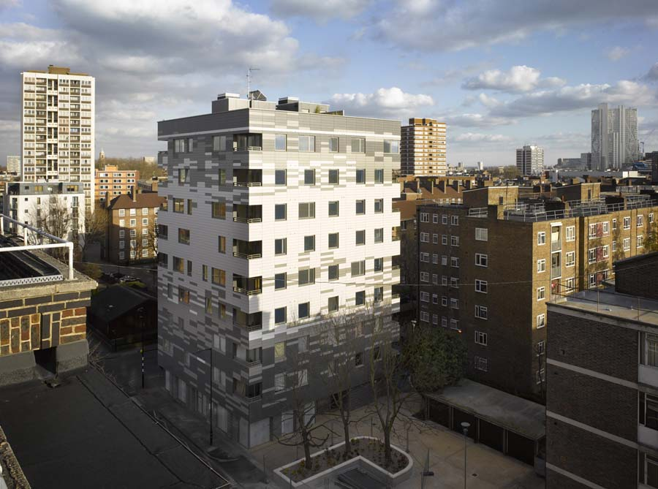
Examples From Around The World
Forte Building
Melbourne, Australia
University of British Columbia
Vancouver, Canada
LifeCycle Tower One
Dornbirn, Austria
Stadthaus at Murray Grove
London, England

Slide 14
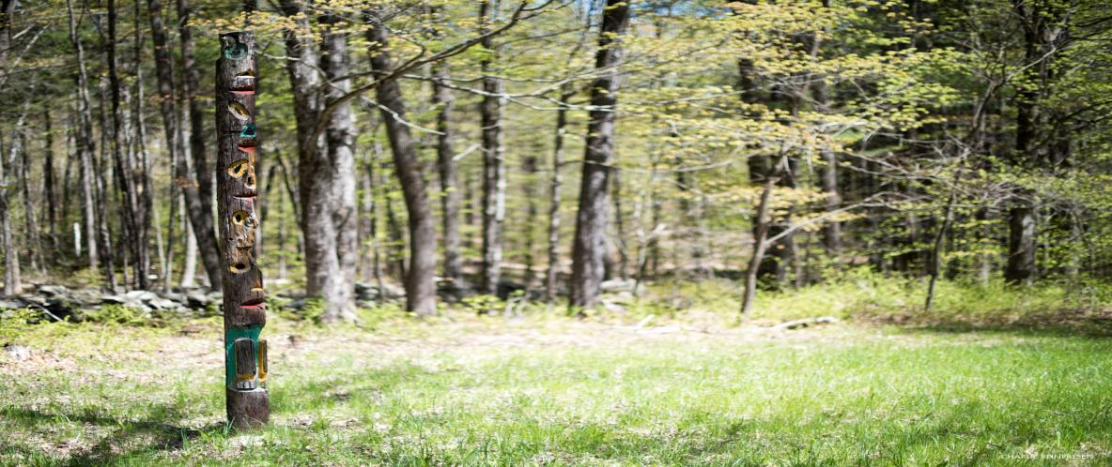
Pooled Timber Income Fund
Is a new planned giving vehicle to help support NEFF’s conservation efforts far into the future through landowner donation of timber sales.

Slide 15
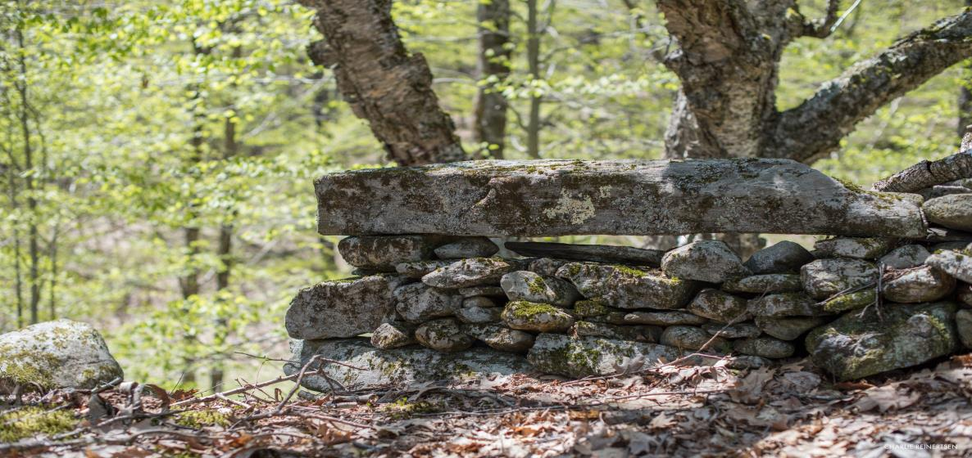
Green TIMO
Is an opportunity for individuals and groups to invest capital in future conserved forest lands.

Slide 16
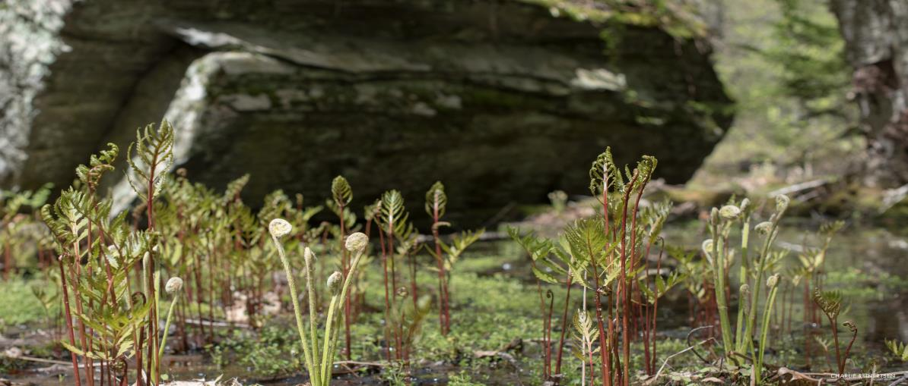
Northern Maine Reverse Auction Fund
Goal is to have conservation interests compete for access to land against for-profit or development interests.

Slide 17
Notes:
- Developed (pink and red) from NYC to CRV. Springfield, Worcester, Boston
- Much forest in northern parts, in much of southern New Eng forest is perforated by development closer to cities
- MassConn development
- MassConn land cover amounts:

Slide 18
Farms, Forest, Water, Wetlands:
~ 175,000 Acres Protected
~ 23% Of Region
How Much Of Each Is Protected?
26% of Forest
19% of Farm Fields
49% of Ponds/Lakes
42% of Wetlands

Slide 19
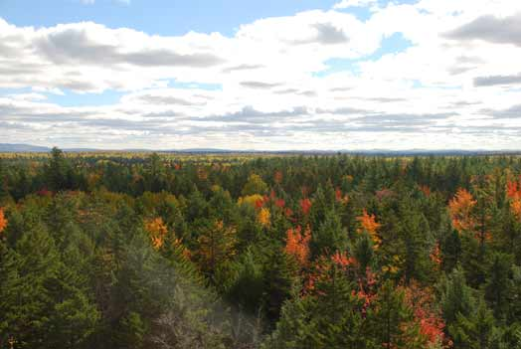

What Does Exemplary Forestry Look Like?
link
Prepared by
New England Forestry Foundation
September 18, 2016

Slide 20
A CAMPAIGN TO CONSERVE THE PAUL TOMASSO MEMORIAL FOREST

Slide 21
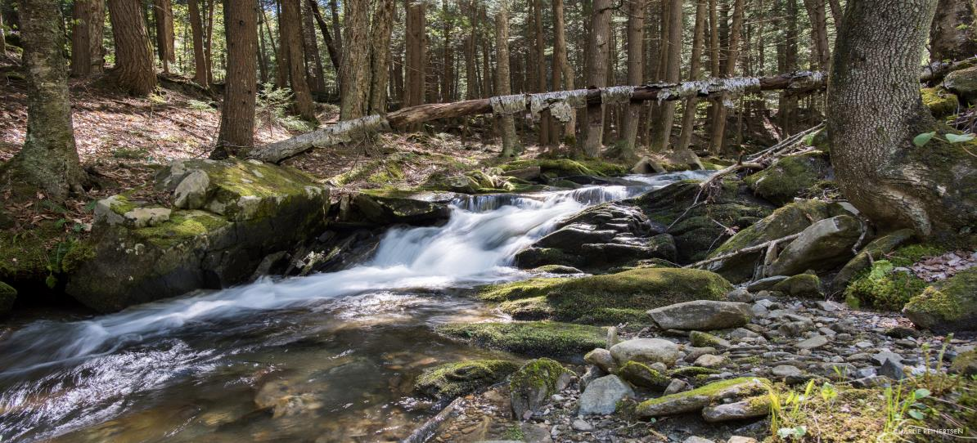
The Snapshot
LOCATION
Chester, Vermont

Slide 22
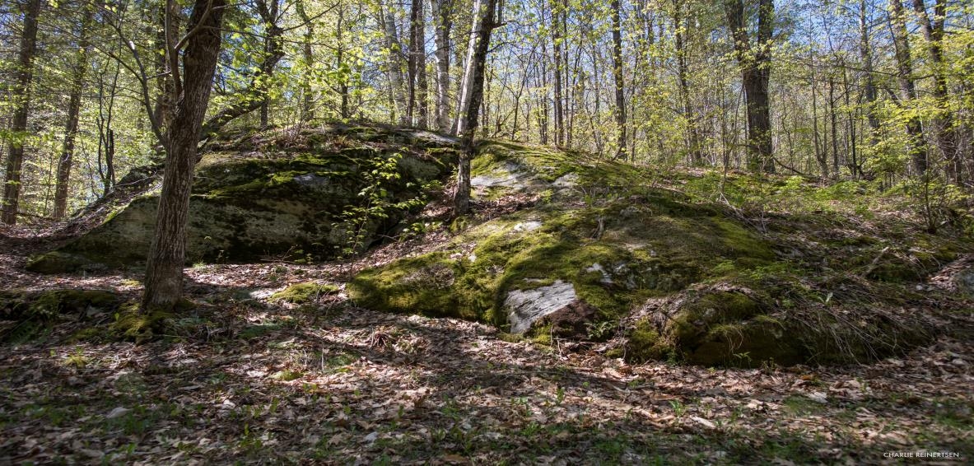
The Snapshot
SIZE
1,811 undeveloped acres

Slide 23
The Snapshot
FEATURES
Vast undeveloped recreational oasis located in the heart of central Vermont
Outstanding trail system ideal for walking, hiking, mountain biking, cross country skiing, snowshoeing and snowmobiling
Diverse habitats – from forest to meadows to wetlands
Mixed hardwood and softwood working forest
Critical habitat for wildlife and migratory birds

Slide 24
The Snapshot
THE THREAT
The New England Forestry Foundation has a one-time opportunity to protect the Tomasso forest and be part of the legacy that the Tomasso Family began decades ago. By conserving this unique forestland and creating public access, it will help prevent the possibility of residential development and the permanent closing of the property to residents and others alike.

Slide 25
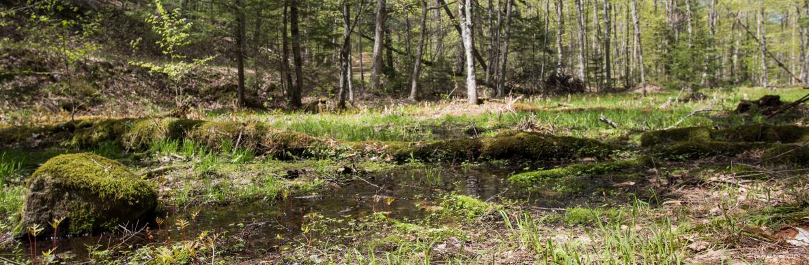
The Snapshot
THE OPPORTUNITY
Located in a rapidly developing part of Vermont, this acquisition offers a one-time opportunity to permanently protect 1,800 acres and open it up to public access.

Slide 26
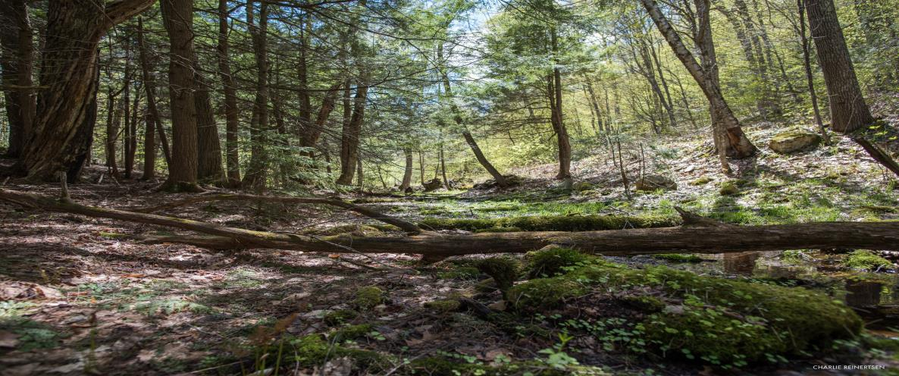
The Snapshot
THE CAMPAIGN
New England Forestry Foundation needs to raise $3.5 million to acquire the property.

Slide 27
